Slide 1

Onboarding – Loops & Arrays
Looking back how loops and arrays work
Trainer: Дарко Панчевски
Assistant: Наташа Панева

Slide 2
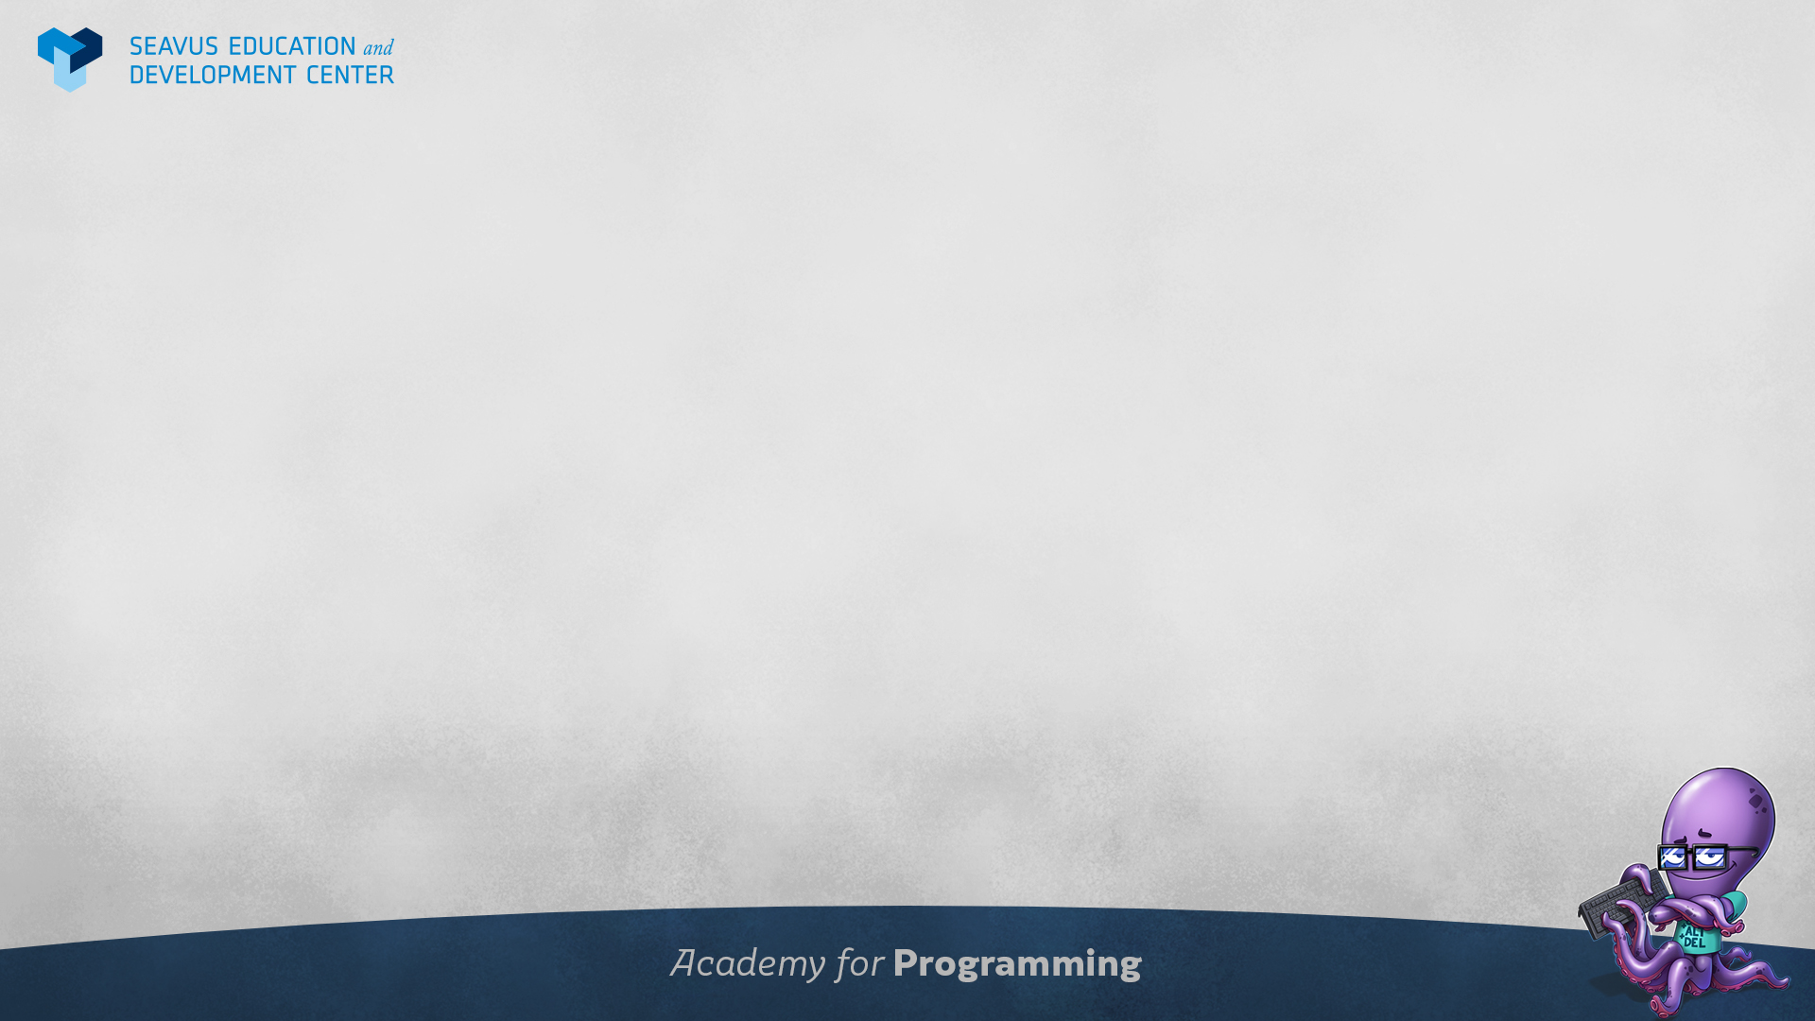
Class plan
Revisiting basic concepts of loops and arrays
Examples of loops and arrays
Exercises with loops and arrays

Slide 3
Looking back at arrays
Arrays are collections of multiple items
In JavaScript we can add any type of item in to an array
Arrays keep track of their items by indexes
Indexing always starts from 0
We can track the number of items of an array with length

Slide 4
Looking back at loops
Loops are used when we need to repeat some code
There are different types of loops
Some loops need counters to manage the cycles
While – Loop that checks a statement and executes code, usually good when handling unknown data like input
Do-While – Loop very similar to While, but it first executes and then checks a statement
For – Loop that has an integrated counter, great for counting
ForOf – Loop that is specifically made for iterating arrays

Slide 5

Questions?

